Slide 1
Semantic Drift
Ullas Basavapatna Chandrashekar, GWID : G35279315
Vishrutha Ravi, GWID : G23527433

Slide 2
Overview of the task

Slide 3
Language changes over time, especially in online communities where new slang and meanings emerge rapidly. This project investigates semantic drift, which refers to changes in how words are used or understood across time.
The system analyzes both historical text corpora and modern social media data to detect how word meanings evolve.

Slide 4
Research Questions

Slide 5
Can combining historical text corpora (news articles) with modern social media data (Reddit) reveal meaningful linguistic evolution in word usage?
Do modern internet communities replace older meanings of words or introduce additional meanings?
How can we automatically detect semantic drift using contextual embeddings?

Slide 6
Motivation

Slide 7
Language evolves continuously, especially in digital communities where new expressions, slang, and meanings spread quickly.
For example :
Traditional linguistic research studies semantic change manually using historical texts.
However, online communities generate new language extremely fast!
Detecting when meaningful linguistic changes occur can help determine when ML models need retraining.
Word | Historical Meaning | Modern Meaning
Cloud | Weather phenomenon | Cloud computing
Tablet | Medicine | Digital Device

Slide 8
Contributions

Slide 9
Data Preparation
Responsible for preparing and organizing the datasets used in the project.
Collected and prepared Reddit datasets from target communities for new meaning sentences.
Implemented the data preprocessing pipeline for Reddit comments.
Used subreddits :
AskReddit
Youtube
GenZ
GenAlpha
Decadeology
Used news dataset for old meaning sentences from Kaggle.

Slide 10
Preprocessing:
Cleaned text data by removing URLs, special characters, and normalizing text.
Structured the Reddit data into monthly JSONL files to support temporal analysis.
For news dataset, downloaded and extracted word frequency timelines.
Designed the project pipeline

Slide 11
Semantic Analysis
Responsible for implementing the core analysis pipeline and semantic drift detection system.
Main contributions:
Implemented Sentence Transformer embeddings to represent contextual meaning.
Implemented the old vs new meaning classification using K-Means Clustering.
Developed visualization system using UMAP.
Evaluation:
Cosine similarity -> Drift score
Silhouette Score and Noise Ratio

Slide 12
Literature Review

Slide 13
Several studies have explored semantic change in language using contextual embeddings.
Hamilton et al. (2016) studied diachronic word embeddings to measure semantic change over time using historical corpora. Their work introduced quantitative methods for measuring semantic drift.
Kutuzov et al. (2018) provided a comprehensive survey of computational approaches for detecting lexical semantic change using neural embeddings and temporal corpora.
Garg et al. (2018) demonstrated that contextual word embeddings can capture temporal linguistic shifts and societal biases across decades of text.

Slide 14
Project Pipeline

Slide 15
Why K-Means :
K-Means cleanly separates sentence embeddings into a small number of interpretable clusters, where each cluster corresponds to a different meaning of the word.

Slide 16
Results and evaluation metrics

Slide 17
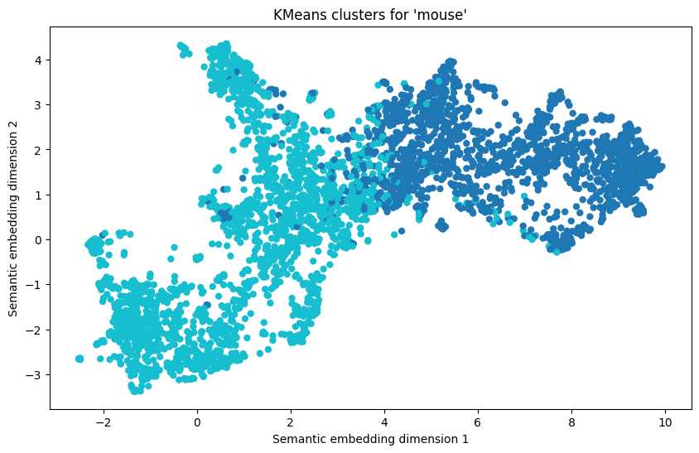
Number of contexts analyzed: mouse: 1500 (news) + 2663 (Reddit)
Drift Score : mouse: 0.125 (partial/moderate drift), which means both meanings exist.

Slide 18
Cluster 0
- But end-users have traditionally downloaded megabytes of information from the web, while uploading only kilobytes of key strokes and mouse clicks.
- Finally, when Google shows you its suggested driving route on the map, you can drag that line onto another road with your mouse.
- We then watch a video of a driver's-eye view of a road (somewhere in Reading, according to the signposts) and click our mouse when we see a hazard.
- Internet Explorer rather redundantly displays the "alt" tag when the mouse is hovered over the image; Firefox doesn't bother because no alternative is needed and there is a `title' tag for captions.
- Now businesses are increasingly using networking tools such as LinkedIn and Facebook to identify those people with the click of a mouse.
- The Air Mouse is a rechargeable cordless mouse that can control a windows PC by being moved through the air or on a flat surface.
- They're tracking where your mouse is on the page, what you put in your shopping cart, what you don't buy.
- Review: Logitech VX Nano Cordless Laser Mouse praise-worthy
- If you miss the scroll bar found on almost every Windows laptops, the two-finger scroll option works well (run two fingers down the touch pad, and it scrolls like a mouse wheel).
Cluster 1
- An Oklahoma State University lab in Stillwater in December could not account for a dead mouse inoculated with bacteria that causes joint pain, weakness, lymph node swelling and pneumonia.
- The only time I thought "what's she got me into now?" was when I was ice skating, holding hands with Minnie Mouse.
- Across the park, hot dog vendors sought refuge under the palm trees" slowly shifting shadows, their carts painted with slap-dash cartoon characters like a Mickeyesque mouse and a clumsily drawn Pokémon.
- Obama Gobbles Down Mouse _ Made of Candy
- Importantly, in the presence of HIV, ZFN-modified CD4 T-cells also preferentially expanded in a mouse model.
- Mouse virus link to breast cancer
- After 40 minutes or so, the upstairs contingent was escorted to a smaller room below, where Mr. Roccoli, dressed in white pants and a grubby Mickey Mouse T-shirt (unbecoming indeed), performed a solo to more extracts from interviews and some uncredited songs.
- In one neighborhood of Rawalpindi, police played a cat-and-mouse game with the protesters.
- Christmas cracker contains dead mouse
- She may be 79 years old, but Minnie Mouse inspires very up to the minute designers.

Slide 19
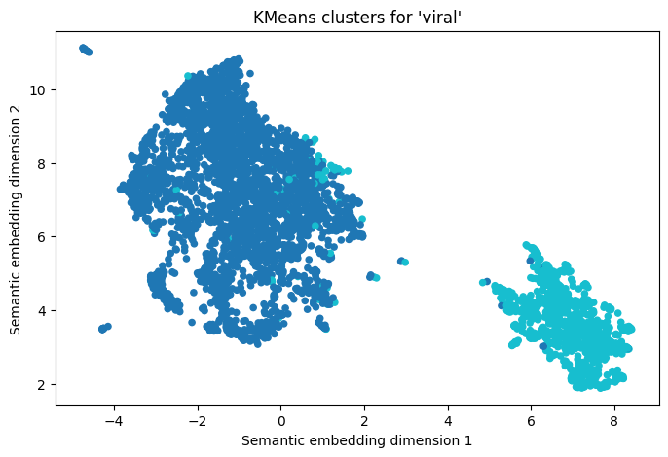
Number of contexts analyzed: viral: 1500 (news) + 2787 (Reddit)
Drift Score : viral: 0.289 (high drift), which means new meaning dominates.

Slide 20
Cluster 0
- Doing the 'Aunt Jackie': A Harlem-filmed rap video goes viral on MySpace.
- Our launch program is built on a Viral Marketing and college grassroots strategy to capitalize on the inherent appeal that we believe ThePeeq.com will have with their audience.
- Viral events are unpredictable.
- By some estimates, the Star Wars kid is the most popular viral video ever, and viewed over one billion times.
- A writer pays for breaking the strike in this "viral" video "Viral" video
- There's no evidence that Adblock Plus or similar products are about to go viral.
- Launched by Sean Parker (a Zuckerberg pal and partner in the Founders Fund, which owns a stake in Facebook) and Joe Green, the application allows Facebook users to tap into the latent viral power of their social networks for good causes.
- Add in the viral nature of the contest and it proved to be a winning formula.
- Loiacono, a Warcraft fan, was looking to create some viral buzz for his start-up, a social networking site called Voig aimed at bringing video game fans together.
- The four artists left standing will battle it out for the (not contagious) "Viral Woodie."
Cluster: 1
- The investigational vaccine used in both ... studies cannot cause HIV infection because it contains only synthetically produced snippets of viral material.
- A viral heart infection called cardiomyopathy is to blame, People magazine reports.
- Two other wards at the hospital have closed to new admissions because three patients have suspected viral gastroenteritis.
- Using the company's proprietary virus-like particle (VLP) and Novasome (R) adjuvant technologies, Novavax is developing vaccines to protect against H5N1 pandemic influenza, seasonal flu and other viral diseases.
- treatment options (which could include surgery, radiation, chemotherapy, transplants, clinical trials, biological, hormonal, viral and complementary therapies and alternative therapies),
- Idenix Pharmaceuticals, Inc., headquartered in Cambridge, Massachusetts, is a biopharmaceutical company engaged in the discovery, development and commercialization of drugs for the treatment of human viral and other infectious diseases.
- Meningococcal disease often begins with symptoms that can be mistaken for common viral illnesses, such as the flu.
- The animal which tested positive had one of the highest viral counts ever observed in a red squirrel, said Dr Shuttleworth, and it was likely that other wild red squirrels would have been exposed to the virus.

Slide 21
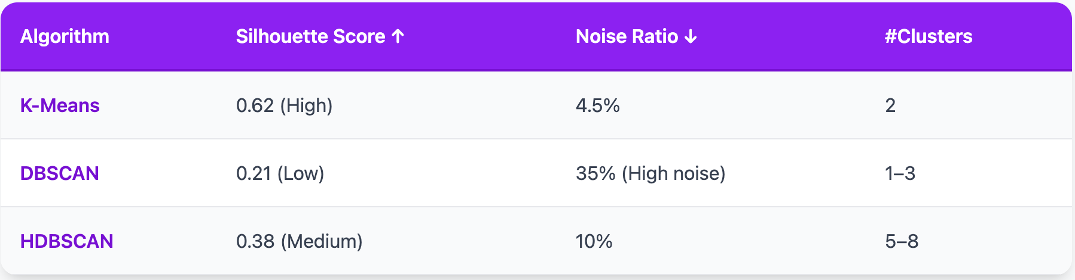
Clustering Comparison

Slide 22
Analysis

Slide 24
Limitations

Slide 25
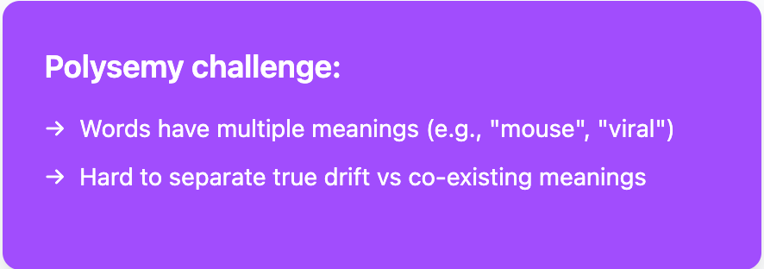
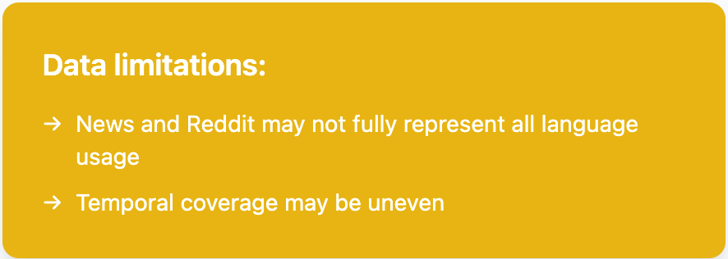
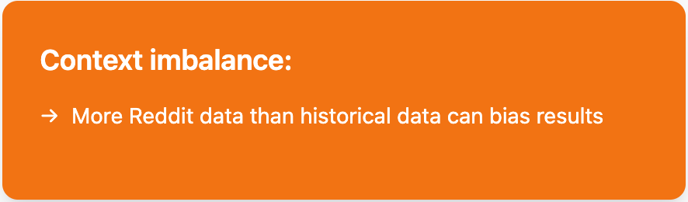

Slide 26
Future Work

Slide 27
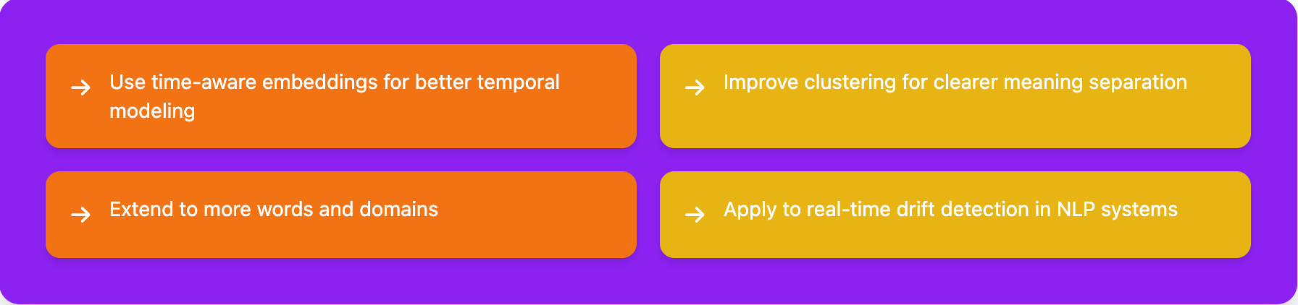

Slide 28
THANKS!

